Slide 1




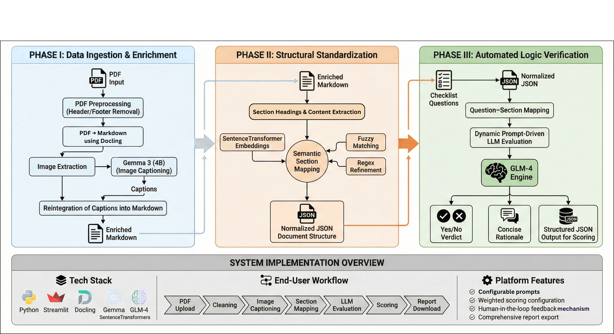
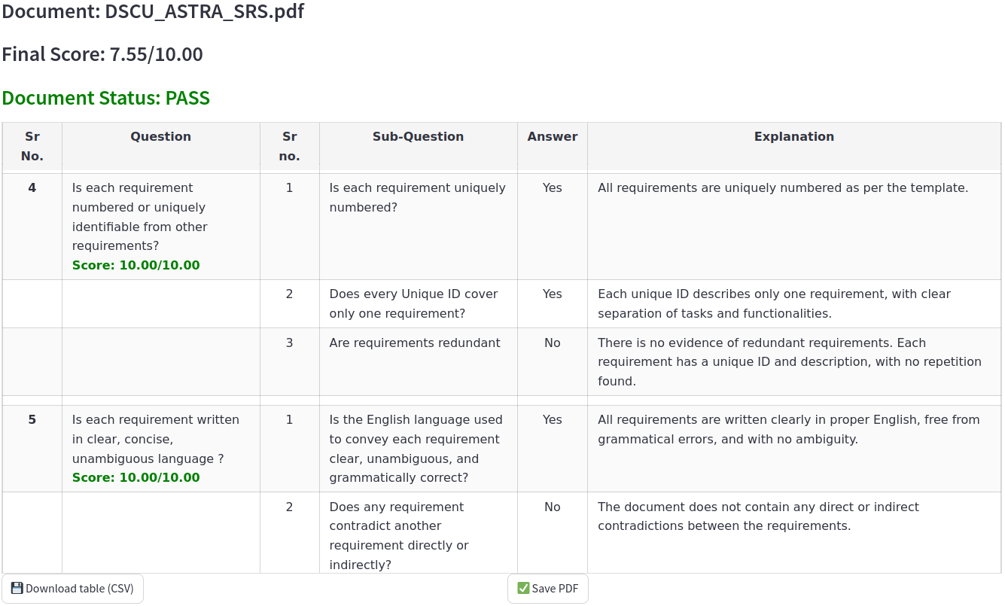
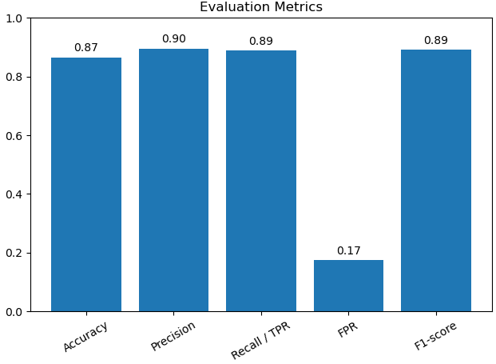

LLM Based Automatic Document Verification For SQAG
Aayush Anand, M.B Sai Charan (Sci-C), A.Kalidasu (Sci-E)
Directorate of Artificial Intelligence & Visualization, RCI DRDO, Hyderabad
OVERVIEW
PROBLEM STATEMENT
OBJECTIVES
The Software Quality Assurance Group (SQAG) under DRDO reviews multiple technical documents such as SRS, SDD, ICD, etc. This project proposes an AI-assisted initial screening system to reduce reviewer burden and improve standardization.
Manual verification of SRS documents by SQAG is time-consuming due to inconsistent formats, terminology, and poorly structured sections.
Additionally, images, flowcharts, state diagrams have to be consistent with the document information.
All of these result in long review time.
Develop an LLM-based automatic Document Verification AI application.
Automatic pre-processing, image captioning, semantic mapping to SQAG processes.
Enable prompt-driven compliance check.
Streamlit dashboard with scoring and reports.
SYSTEM ARCHITECTURE
RESULT & EVALUATION
Confusion Matrix
Actual YES
120
15
Actual NO
14
66
Predicted YES
Predicted NO
Fig-2: Confusion Matrix
Fig-3: Standard derivatives
The system was benchmarked against the ground‑truth dataset. The key metrics are:
Faithfulness: 0.783
Relevance: 0.849
Contextual Acc: 0.616
Fig-1: Result page with Document XXXXX Score
The accompanying confusion matrix(Fig-2) and its standard derived measures (Fig-3) illustrate classification behavior.
CHALLENGES
In the Fig-1, the document (XXXXX_SRS.pdf) undergoes a thorough review, scoring 7.55/10. It demonstrates clear, unambiguous requirements, unique IDs, and absence of redundancy or contradictions, confirming a well-structured SRS.
Irregular SRS Formats
Complex Diagrams & Figures
Semantic variation in sections
LLM Prompt Sensitivity & Grounding
CONCLUSION
FUTURE WORK
The project presents an LLM-based system for SRS verification that reduces manual review effort and enables structured, explainable compliance evaluation. It demonstrates the effective use of multimodal LLMs and modular AI pipelines for intelligent document processing in defence workflows.
Support for SDD, ICD, STR documents
Automatic template detection, Feedback option, User authentication & access control.
Research Center Imarat, RCI, Hyderabad, 500069
Notes:
1

